Slide 1

OSU BOOK
EXCHANGE
By SYSBM

Slide 2

ABOUT
01
FEATURES
02
DATABASE
04
DEMO
TABLE OF CONTENTS
03
OBSTACLES + FUTURE
05
CONCLUSION
06
About the project and about SYSBM’s goals
Explaining all of our features like Bootstrap, admin view, etc!
All about our models, controllers, views.
Showing off our website.
Problems we had throughout development, and what we would do if we had more time
Answering questions

Slide 3
01
ABOUT

Slide 4
ABOUT
SYSBM wanted to create an OSU Book Exchange that was similar to classified advertisements website like Craigslist to allow students sell their used textbooks to each other. To keep students safe, we make sure they have a proper OSU email when they make an account.
SYSBM’s goal was to help students sell and buy books at better rates/payouts than buying new/selling at a used bookstore.

Slide 5
REQUIREMENTS
From the 3901 project site:
Create a marketplace for used OSU textbooks
Allows students to register their books for sale and find books to buy
Have both priced and condition in the listings for sale

Slide 6
02
FEATURES

Slide 7
BASIC FUNCTIONALITY
SITE FUNCTIONALITY
ADMINS
USERS
DELETE USERS
BUY
SEARCH
SELL
Admins have to have the ability to delete users to moderate the sites.
Users have to have the ability to buy books that they want.
Users have the ability to search for books by class, book title, author and isbn.
Users have to have the ability to sell the books that they want to sell.

Slide 8


CUSTOM GRAPHICS

Slide 9
WE WANT MORE
So SYSBM added extra functionality:
Extensive search features
Following/Followers
Scam prevention
User protection
Web responsiveness

Slide 10
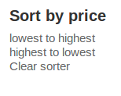
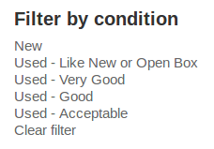
SEARCHING EASILY
Search by:
Sort by:
Filter by:
Class
Title of book
Author
ISBN
Price low to high
Price high to low
5 book conditions

Slide 11
FOLLOW/FOLLOWING
Users that have more followers are more reliable and trusted sellers.
Allows smarter and more trusted buying!
Slight scam prevention from this trusted buyer/following system.

Slide 12




SCAM PREVENTION
OSU Email
Buy/Sell access
Require users to sign up using their OSU email.
Allows only logged in students to buy AND sell books

Slide 13
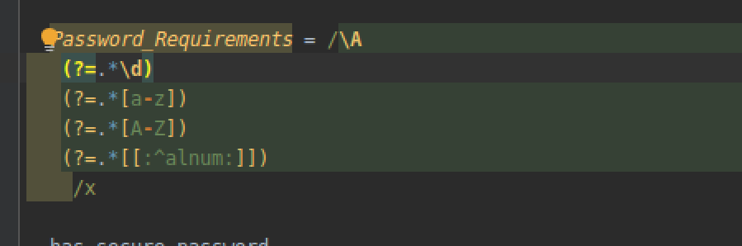
USER PROTECTION
Strict Passwords
Protected Permanent Cookies
Require users to sign up with a complex password.
User can let the website remember them, and we make sure to protect these cookies.

Slide 14


PROTECT THE COOKIES
Four main ways to steal cookies and how we protect our users from it:
Packet sniffing → prevent by using Secure Sockets Layer (SSL)
Compromising the database → stores a hash digest of tokens instead
Cross-site scripting → Rails protect us naturally by escaping content inserted into view templates
Gaining physical access → No perfect way to prevent this but we change tokens when users log out

Slide 15
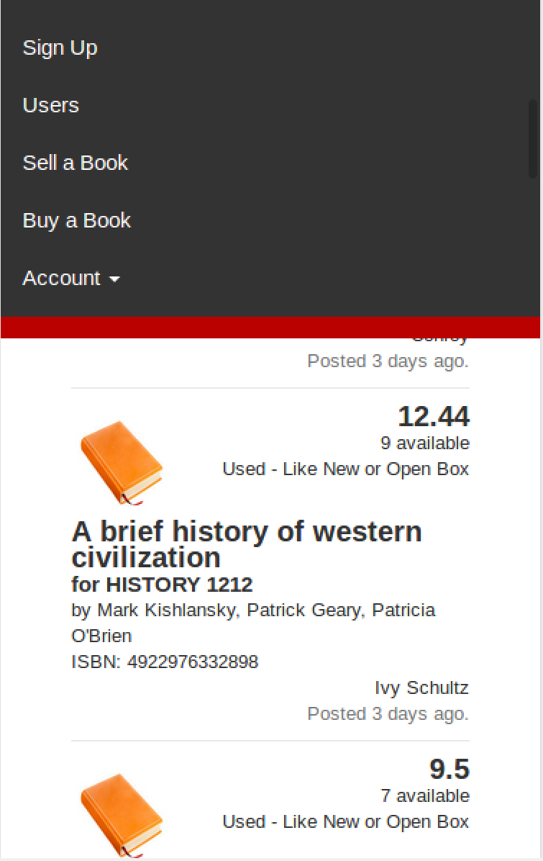
WEB RESPONSIVENESS
By using Bootstrap!
Access quickly from your phone on the go!

Slide 16
USER EXTRAS
EDIT PROFILE
DELETE POSTS
Allows students to edit their passwords.
Allows students to delete expired or accidental posts/listings.

Slide 17
03
DEMO

Slide 18
04
DATABASE

Slide 19
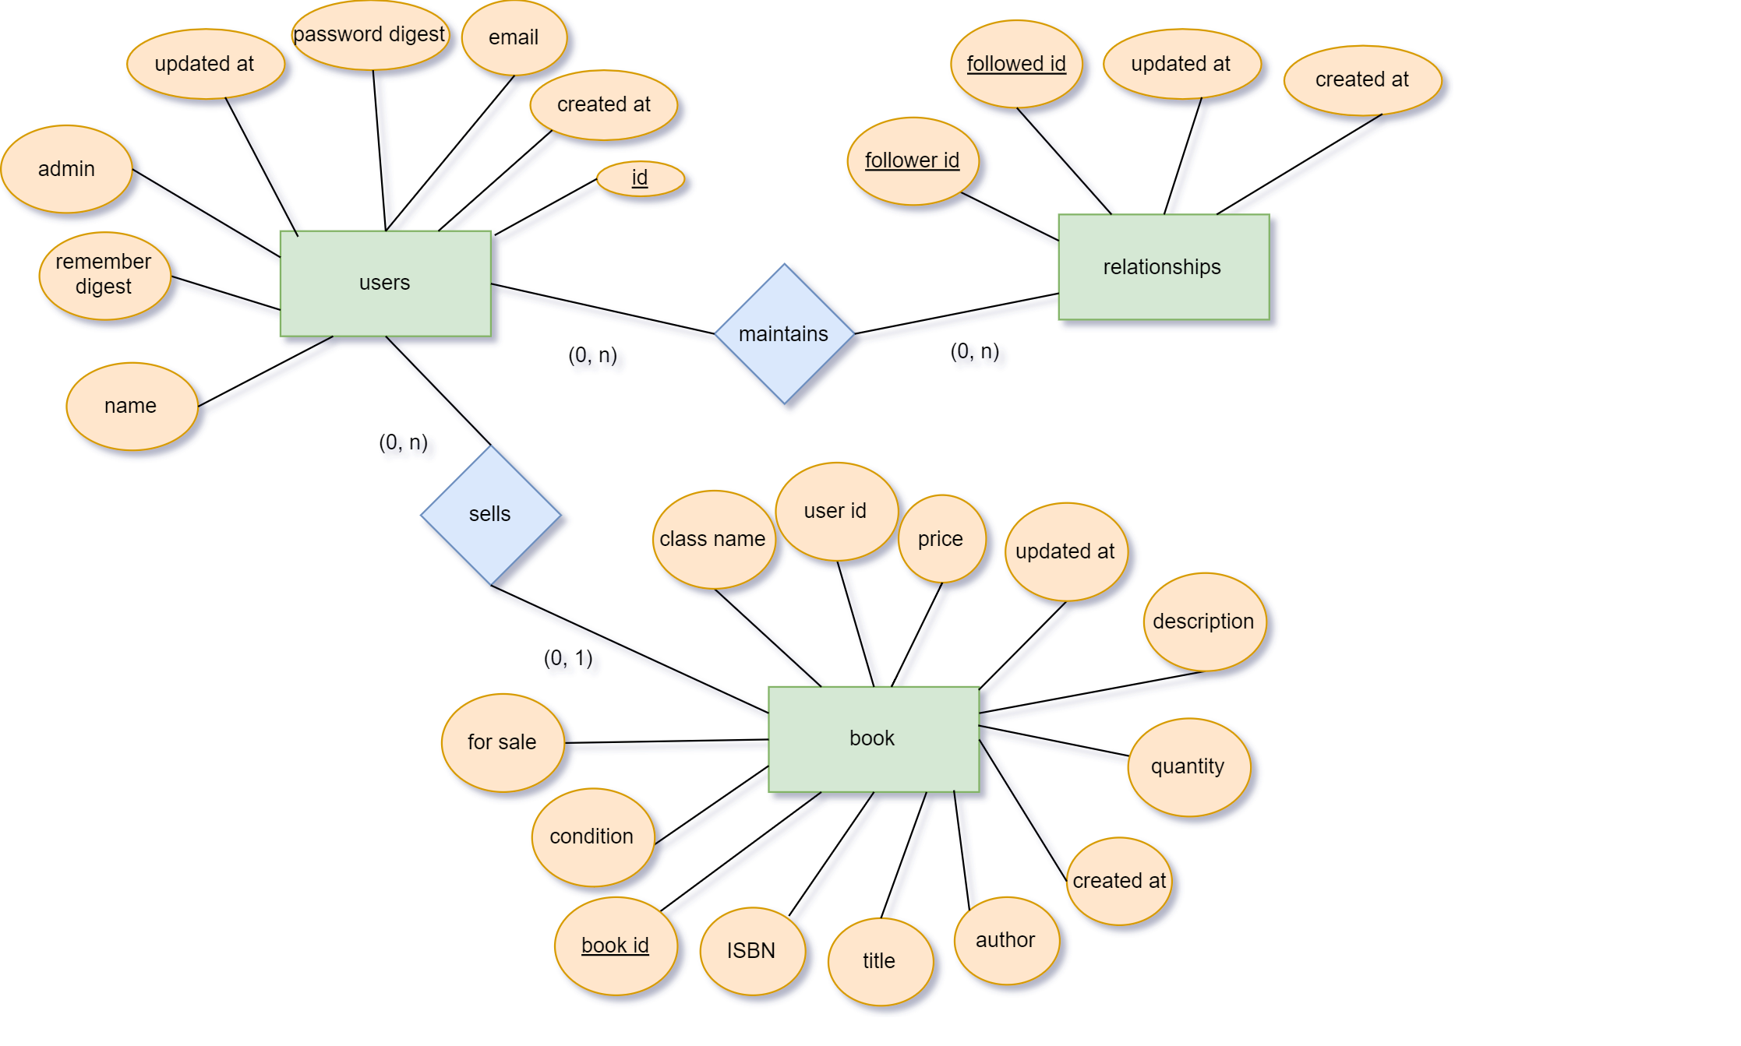
ENTITY-RELATIONSHIP DIAGRAM

Slide 20
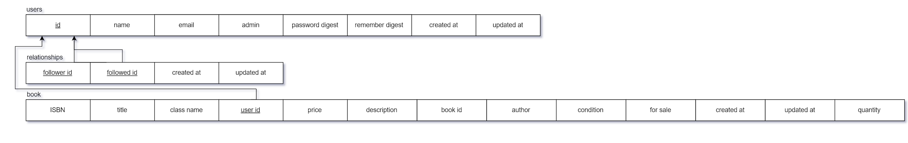
RELATIONAL SCHEMA

Slide 21
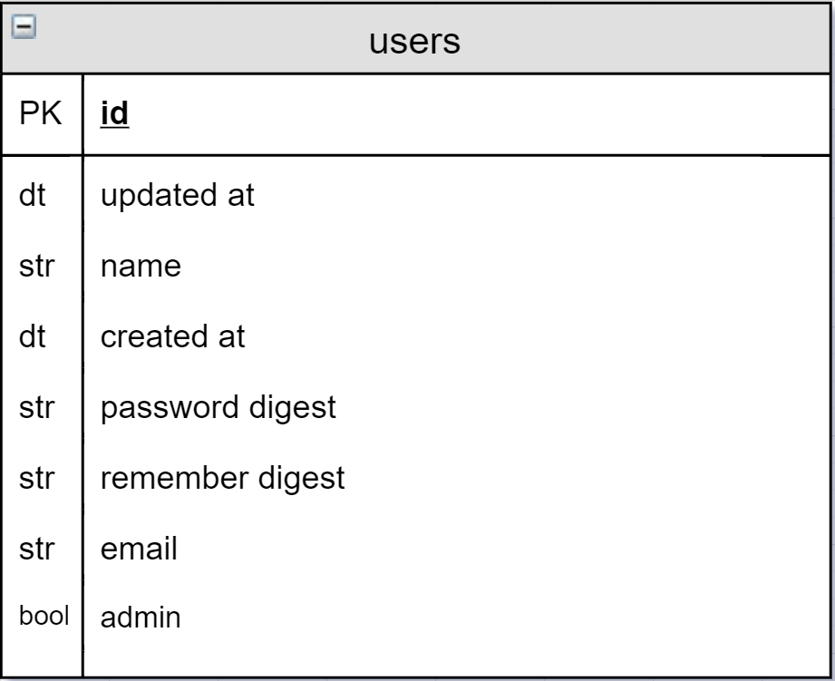
User Model
Full of things we need for the user, like their email, name, and whether or not they are an admin.
Password digest and remember digest are used to store password data that will be encrypted by bcrypt (uses derived blowfish cipher with salt)
Symmetric key encryption (shared secret between Alice and Bob)

Slide 22
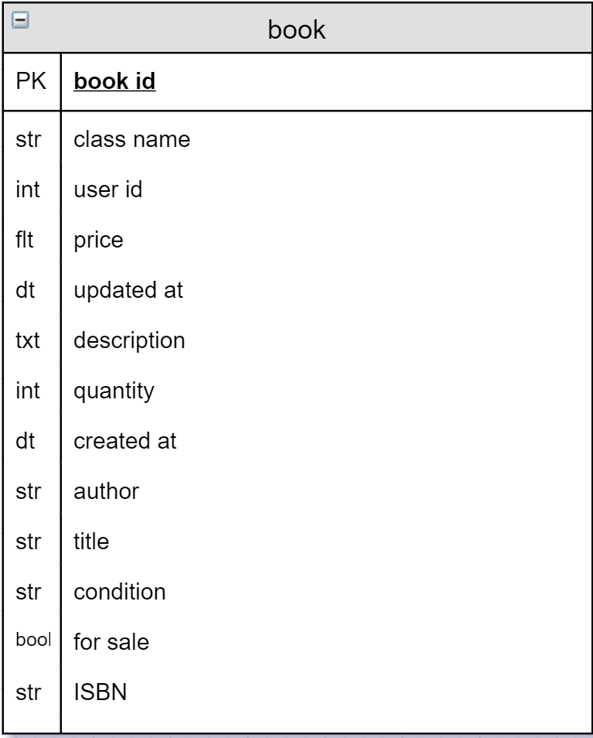
Book Model
Full of things we need for books, like the seller of it, the price, and other features.
These are used when users submit listings or search for listings!

Slide 23
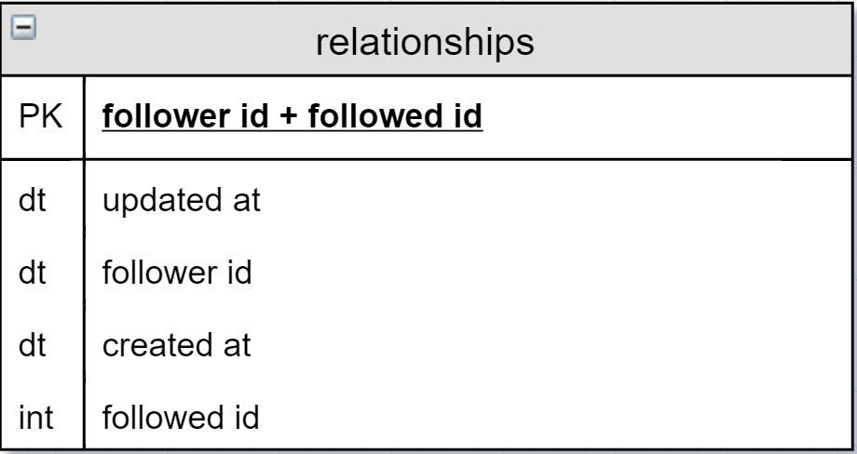
Relationships Model
The controller for our follower/following feature
Superkey of follower id + followed it to identify unique user

Slide 24
05
OBSTACLES + FUTURE

Slide 25
OBSTACLES
BCRYPT
TEST CASES
LEARNING RAILS
COOKIES
DIRECTORY
SORTING
Difficulty to get it working initially, required the version given in the book to be changed and to install bcrypt by itself.
We had a hard time creating and ensuring our test cases were correct.
There were a lot of times where we had to find resources outside of the book to do what we wanted.
Figuring out how to keep them protected was a bit rough, and took a lot of reading and research.
There were a lot of folders and subfolders, finding our way around was very confusing at first.
The sorting/filtering/search feature was rather complex and took up a good chunk of time.

Slide 26
WHAT WE WANTED TO DO
Email Verification
Search Filtering
Administrative
Paginate
Trade Page
User would get an email to verify their account before being able to login.
Instead of links, use an HTML form to submit search criteria.
Figure out how to make admin accounts be able to delete posts as well
Fix it and figure out why it disappears after search
Page where two users can confirm that the book listed has been sold for the appropriate price. Then both users would receive some sort of internet “karma”

Slide 27
06
CONCLUSION
That brings us to the end of our slides. Are there any questions?

